Slide 1

THE TITANIC
Introduction to Data Science Project
Group Members – Anosh Pesuna, Devika S Nair, Kylie/Minh Thai, Mrudav Mehta, Nilay Srivastava, Prakriti Bhatia, Thao Chu

Slide 2

Understanding the Training Data
PassengerId – The unique identification number given to each passenger
Survived – In this column, 1 indicates that the passenger survived, and 0 indicates otherwise
Name, Sex, Age – The names, ages, and the sex of passengers aboard
SibSp – The number of siblings or spouse(s) present aboard
Parch – The number of parents or children present aboard
Ticket – The ticket number of each passenger
Fare – The price that each passenger had to pay for their ticket
Cabin – The cabin code of a passenger
Embarked – The Titanic picked up passengers from 3 destinations – C for Cherbourg, S for Southampton, and Q for Queenstown

Slide 3

The Code

Slide 4
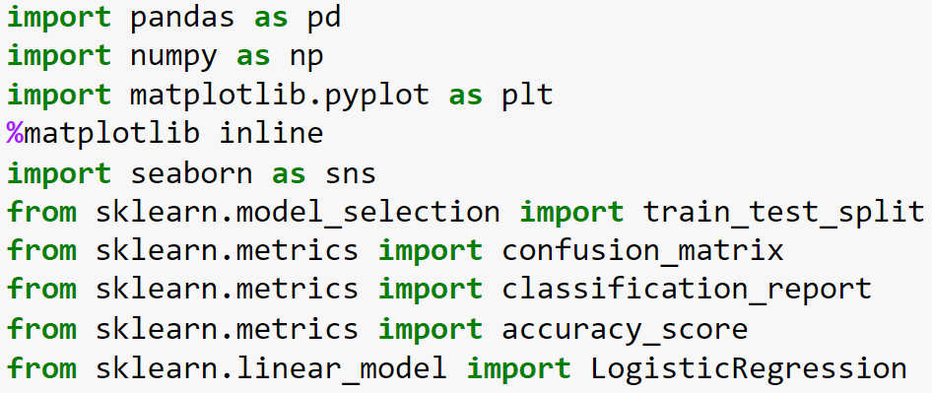

Importing all important libraries

Slide 5
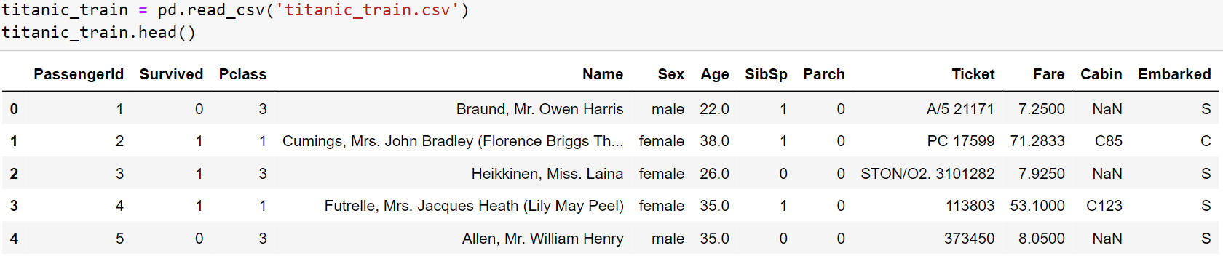
Reading the CSV file and viewing the first few rows

Slide 6
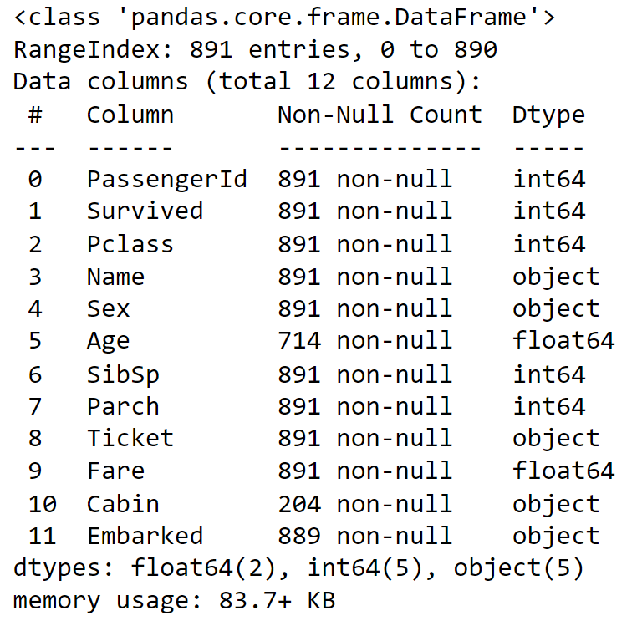
Information about the training data
titanic_train.info()
Before we dive into the EDA, let’s see the information we can get from the training data

Slide 7

In this section of the presentation, let’s have a look at the graphs which give us a visual summary of our data.
The code for the same can be found in the submitted Jupyter Notebook

Slide 8
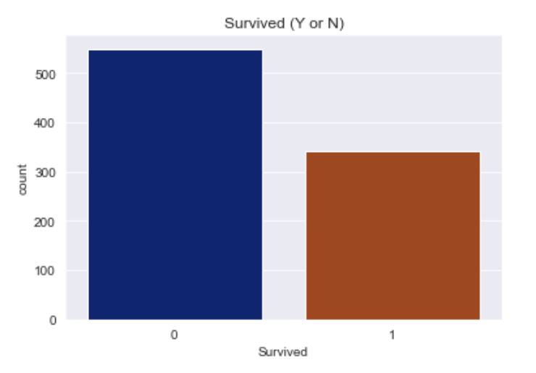
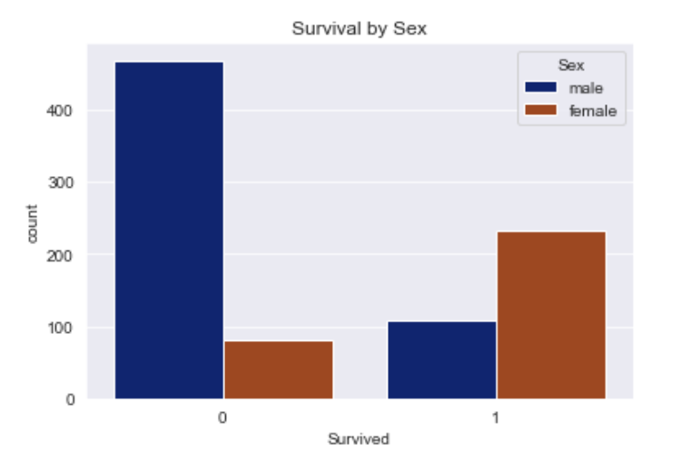

Slide 9
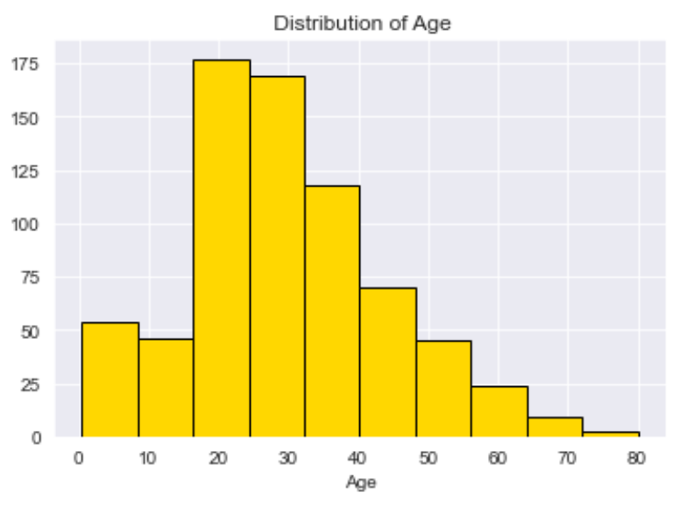
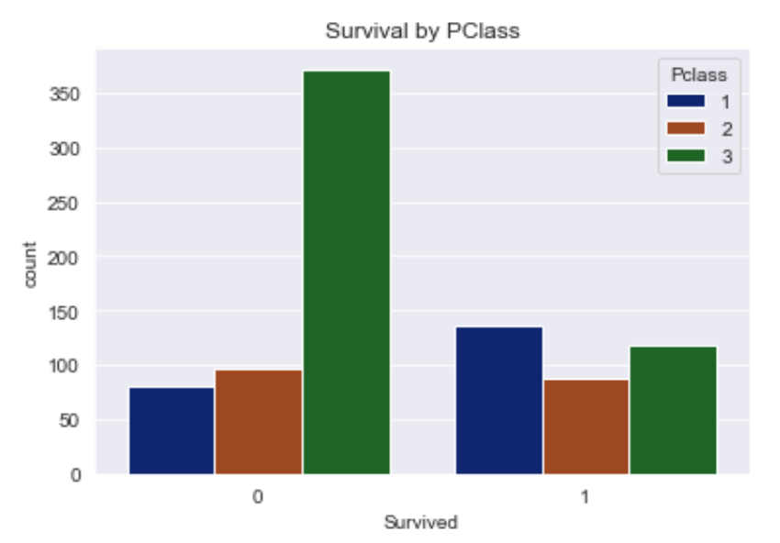

Slide 10
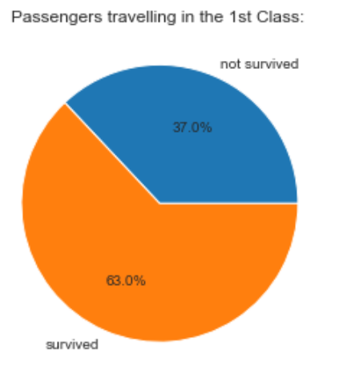
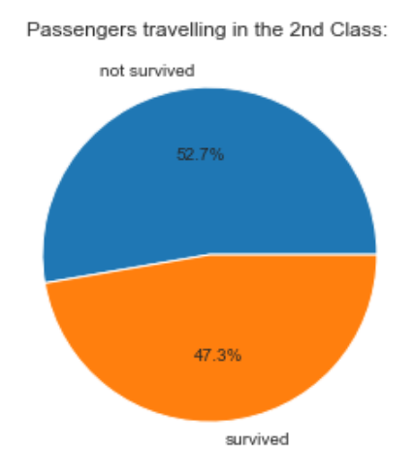
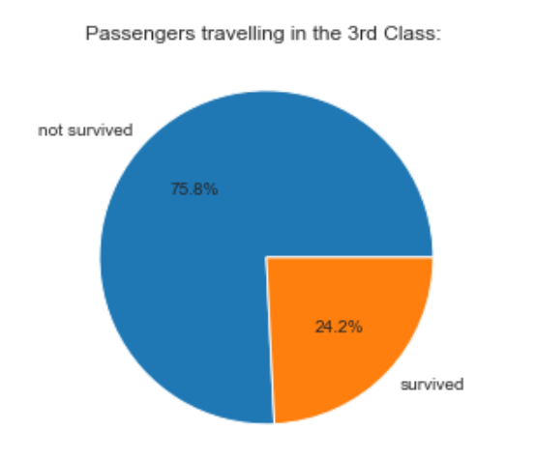

Slide 11
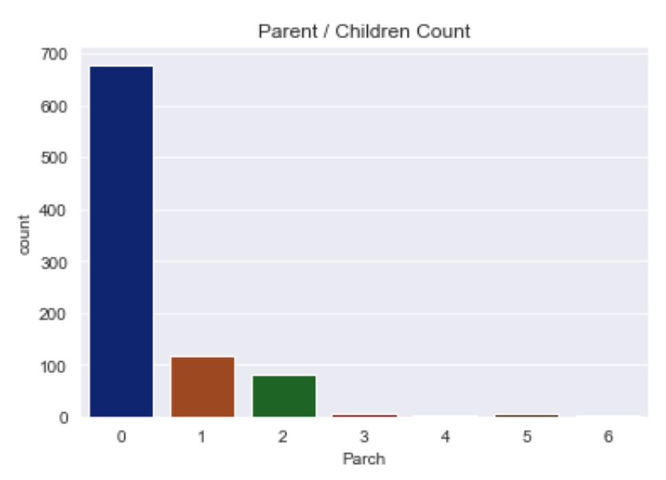
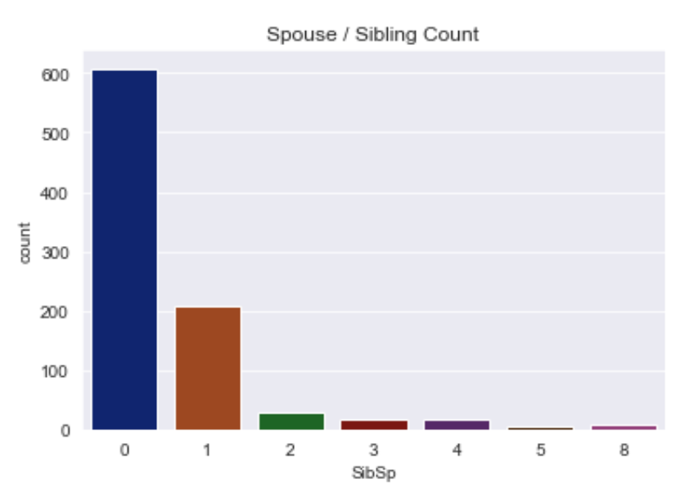

Slide 12
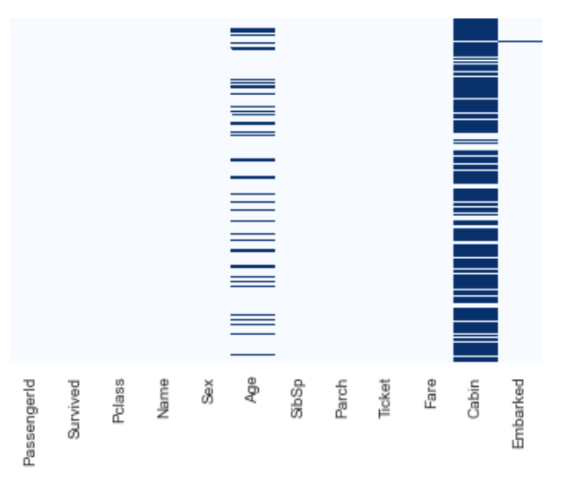

Checking for missing data
From the output, we can see that the columns Age and Cabin have a lot of null values
The column Embarked has very few Null values (2 to be precise)

Slide 13
Data cleaning
Imputing the missing values in Age-based Pclass
titanic_train['Age']=titanic_train['Age'].groupby([titanic_train['Pclass']]).apply(lambda x: x.fillna(x.mean()))
Dropping the cabin column
titanic_train.drop('Cabin',axis=1,inplace=True)
Modified DataFrame

Slide 14

Data cleaning
Checking Null values in the 'Embarked' column
titanic_train['Embarked'].isnull().value_counts()
We have 2 null values based on the output
Dropping the NaN values in Embarked
titanic_train.dropna(axis=0,subset=['Embarked'],inplace=True)
No null values

Slide 15
Dummy variables
Converting categorical features (sex, embark) to dummy variables using get dummies
We are using get_dummies because if not used, the categorical data can't be used as inputs by the model
sex = pd.get_dummies(titanic_train['Sex'],drop_first=True)
embark = pd.get_dummies(titanic_train['Embarked'],drop_first=True)
titanic_train.drop(['Sex','Embarked','Name','Ticket'],axis=1,inplace=True)
titanic_train=pd.concat([titanic_train,sex,embark],axis=1)
titanic_train

Slide 16
Logistic Regression Model
In the Logistic Regression model, we have an X variable and a Y variable. The Y variable is Survived (binary).
And the X variable is everything apart from Survived, hence:
The X array can be obtained by → titanic_train.drop('Survived',axis=1)
And, the Y variable is Survived, is obtained by → titanic_train['Survived’]
Building a logistic regression model with a 70 : 30 train : test split:
Fitting the model → logreg.fit(X_train, y_train)
Predicted values → yhat=logreg.predict(X_test)

Slide 17
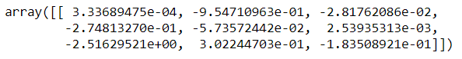
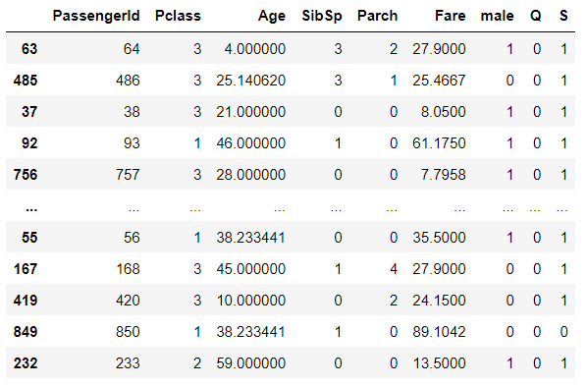
Prediction and evaluation of the model
array of coefficients
logreg.coef
predicted values
predictions = logreg.predict(X_test)
predictions
X_test

Slide 18
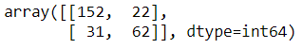
Confusion Matrix
Confusion Matrix
confusion_matrix=confusion_matrix(y_test,yhat)
confusion_matrix
Accuracy score
accuracy_score(y_test, yhat)
Accuracy score = 0.8014981273408239

Slide 19
Classification report
print(classification_report(y_test,yhat))
 | Precision | Recall | F1-score | Support
0 | 0.83 | 0.87 | 0.85 | 174
1 | 0.74 | 0.67 | 0.70 | 93
accuracy |  |  | 0.80 | 267
macro avg | 0.78 | 0.77 | 0.78 | 267
Weighted avg | 0.80 | 0.80 | 0.80 | 267

Slide 20

Feature Engineering

Slide 21

Title as a feature
Extracting title from the data;
titanic_train['Title'] = titanic_train['Name'].str.extract(' ([A-Za-z]+)\.')

Slide 22
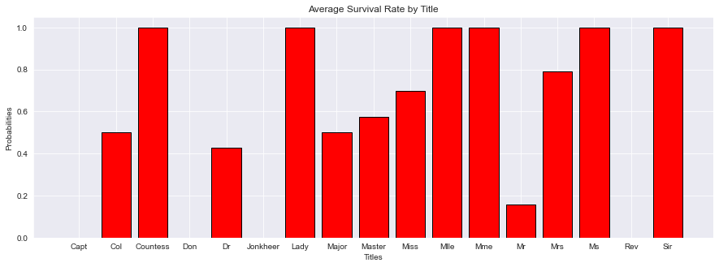
Average survival rate by title
p_title=titanic_train3['Title'].unique()
p_title.sort()
title_sr=titanic_train3.groupby(['Title'])['Survived'].mean()
plt.figure(figsize=(15,5))
plt.bar(p_title,title_sr,color='red',edgecolor='k')
plt.title('Average Survival Rate by Title')
plt.xlabel('Titles')
plt.ylabel('Probabilities')

Slide 23

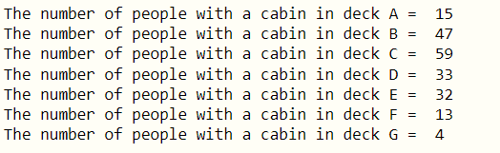
Cabin as a feature
Cabin data
cabin_count=[]
for i in titanic_train2['Cabin']:
cabin_count.append(i[0])
print("The number of people with a cabin in deck A = ",cabin_count.count('A'))
print("The number of people with a cabin in deck B = ",cabin_count.count('B'))
print("The number of people with a cabin in deck C = ",cabin_count.count('C'))
print("The number of people with a cabin in deck D = ",cabin_count.count('D'))
print("The number of people with a cabin in deck E = ",cabin_count.count('E'))
print("The number of people with a cabin in deck F = ",cabin_count.count('F'))
print("The number of people with a cabin in deck G = ",cabin_count.count('G'))

Slide 24
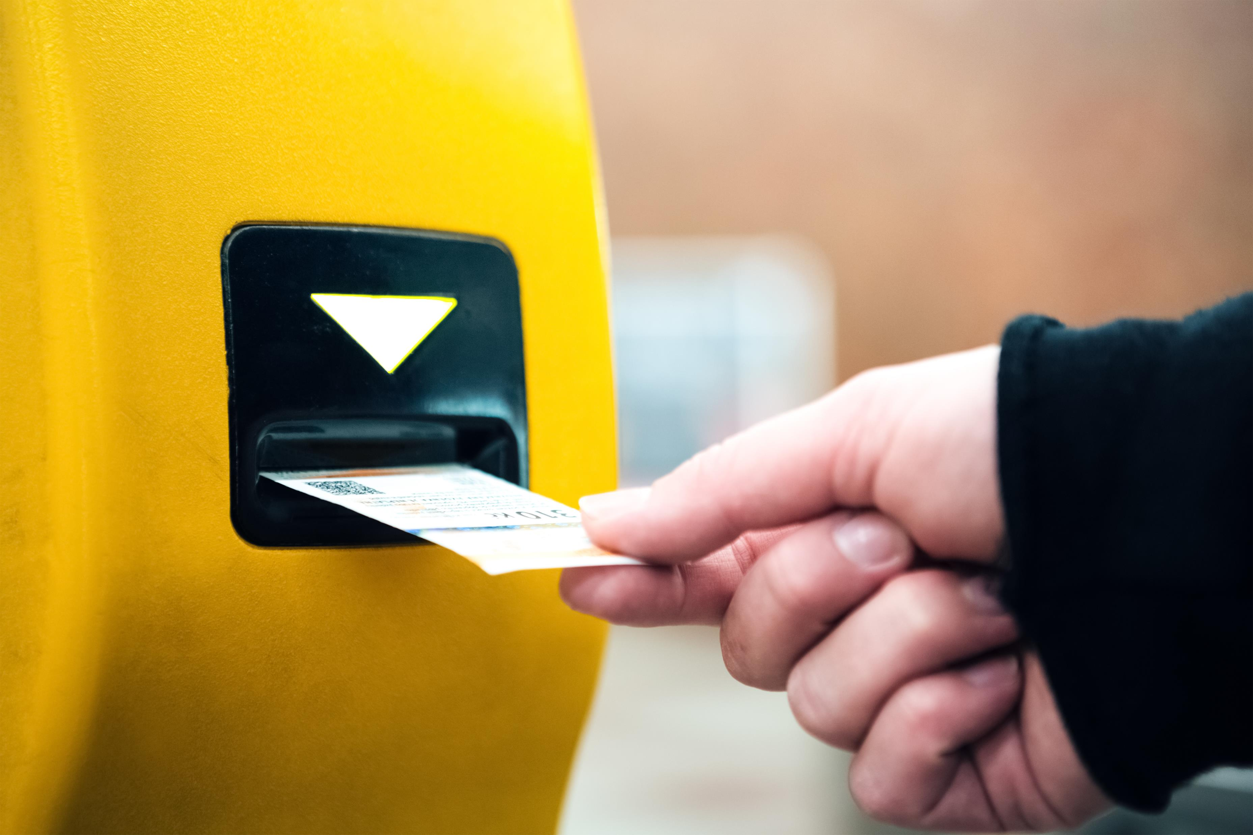
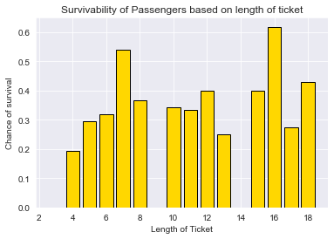
Ticket as a feature
Survival rate by ticket length
titanic_train3['Ticket_Len'] = titanic_train3['Ticket'].apply(lambda x: len(x))
titanic_train3.groupby(['Ticket_Len'])['Survived'].mean()
abc=titanic_train3['Ticket_Len'].unique()
xyz=titanic_train3.groupby(['Ticket_Len'])['Survived'].mean()
plt.bar(abc,xyz,edgecolor='k',color='gold')
plt.xlabel('Length of Ticket')
plt.ylabel('Chance of survival')
plt.title('Survivability of Passengers based on length of ticket')

Slide 25
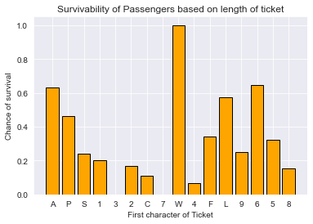
Survival rate based on ticket letter
titanic_train3['ticket_letter'] = titanic_train3['Ticket'].apply(lambda x: str(x)[0])
titanic_train3.groupby(['ticket_letter'])['Survived'].mean()
titanic_train3.groupby(['ticket_letter'])['Survived'].mean()
a=titanic_train3['ticket_letter'].unique()
b=titanic_train3.groupby(['ticket_letter'])['Survived'].mean()
plt.bar(a,b,color='orange',edgecolor='k')
plt.xlabel('First character of Ticket')
plt.ylabel('Chance of survival')
plt.title('Survivability of Passengers based on length of ticket')

Slide 26

Conclusion
Data in the real world is not always neatly arranged, it is important to clean the data and then work on it for getting the best results.
It is also vital to get your way around missing data, and still continue to build a model, as we have done.
Visualisation of the data in hand is equally important, as just a bunch of numbers on a screen would not give a good idea about the data. Here, by visualising the data we found out how the survival rate of a passenger depended upon his/her sex, passenger class, deck, etc.
Once the data is cleansed, building a model and validating it is the next step. We have also seen how some factors may affect the rate of survival.

Slide 27

Contributions
Anosh Pesuna – PPT, EDA
Devika S Nair – PPT, feature engineering, data cleaning
Kylie/Minh Thai – Feature Engineering
Mrudav Mehta – Model building, feature engineering, EDA, PPT
Nilay Srivastava – Validating the model, data cleaning
Prakriti Bhatia – Interpretations of the model,
Thao Chu – EDA, PPT

Slide 28

Thank you!

